Slide 1

HNDIT2417
Mobile Application Development
www.hndit.com
Week 5-6- Fragments

Slide 2
Fragments
www.hndit.com

Slide 3
Fragment
www.hndit.com
A Fragment is a portion of the graphical interface of an Activity. It has its own life cycle and can be added or removed while the Activity is in the foreground.
A Fragment is added to an Activity within a ViewGroup because the Fragment defines its graphical interface.
Each Activity has a Back Stack to preserve the states of all the Fragments replaced in its graphical interface.
Pattern: it is recommended to develop a Fragment which can be reused in any other Activity regardless of the type of terminal or configuration.

Slide 4
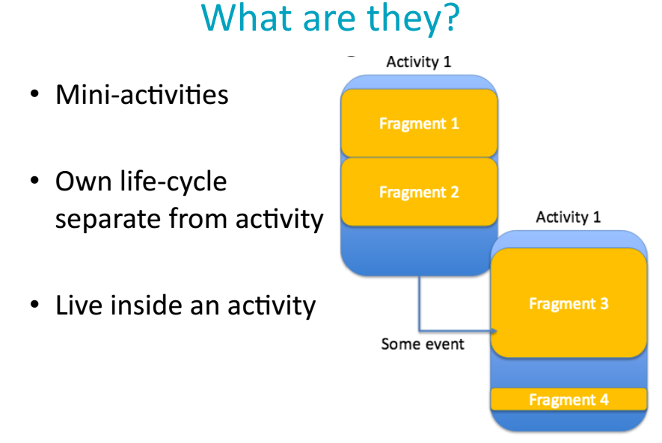
www.hndit.com

Slide 5
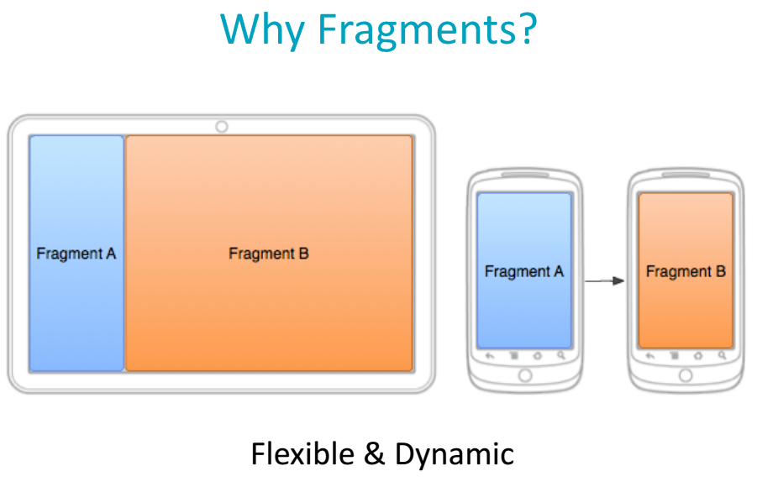
www.hndit.com

Slide 6
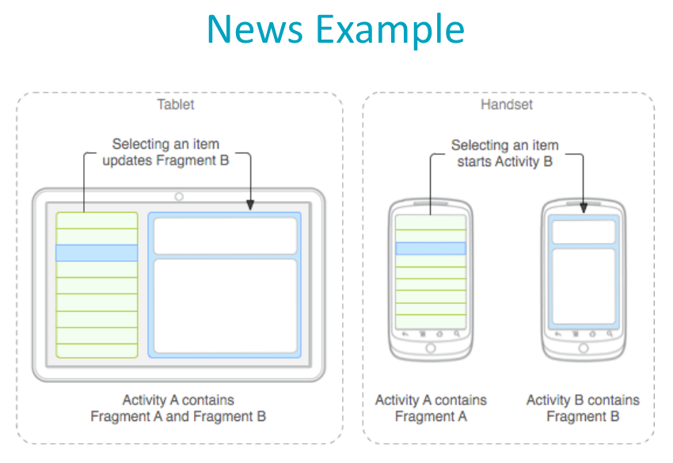
www.hndit.com

Slide 7
Fragment Life Cycle
www.hndit.com
To create a Fragment the class must extend the Fragment class. The life cycle of a Fragment is very similar to that of the Activity.
The lifecycle differs from the Activity one for:
  onAttach(): the Fragment has been inserted in the GUI of Activity
  onCreateView(): it is used to define the View, which is the interface of the Fragment and that ends up in the hierarchy of Activity
  onActivityCreated(): the Activity.onCreate() is executed
  onDestroyView(): the view is destroyed
  OnDetach(): there is no longer any connection between the Fragment and Activity.

Slide 8
User Interface
www.hndit.com
A Fragment can not have a graphical interface. If you want to assign a layout to a Fragment you must use the method Fragment.onCreateView().
@Override
public View onCreateView(LayoutInflater inflater, ViewGroup container,
Bundle savedInstanceState) {
return super.onCreateView(inflater, container, savedInstanceState);
}
  Inflater: useful to retrieve a view from an xml file in layout folder
  Container: the ViewGroup that contains the Fragment
  SavedInstanceState: the Bundle used to retrieve data saved before destroying as for Activity lifecycle

Slide 9
Fragment Activity adding
www.hndit.com
There are 2 ways to allocate and add a Fragment to an Activity:
  Layout file: when the Activity prepares its GUI and finds a <fragment /> tag, a Fragment is instantiated using the class defined in:
android:name="com.example.fragment.ExampleFragment"
  FragmentTransaction: you can add a Fragment to the Activity at any time when it is in the foreground using the FragmentManager and FragmentTransaction objects.
A Fragment must have a tag for its identification inside Activity backstack. In both cases, you can define a tag as a string.

Slide 10
Fragment Activity adding – Layout File
www.hndit.com
<?xml version="1.0" encoding="utf-8"?>
<LinearLayout xmlns:android="http://schemas.android.com/apk/res/android"
android:layout_width="match_parent"
android:layout_height="match_parent"
android:orientation="horizontal" >
<fragment
android:id="@+id/list"
android:name="com.example.news.ArticleListFragment"
android:layout_width="0dp"
android:layout_height="match_parent"
android:layout_weight="1" />
<fragment
android:id="@+id/viewer"
android:name="com.example.news.ArticleReaderFragment"
android:layout_width="0dp"
android:layout_height="match_parent"
android:layout_weight="2" />
</LinearLayout>

Slide 11
Fragment Activity adding – FragmentTransaction
www.hndit.com
In order to add a Fragment to an Activity at runtime you need to do the following:
FragmentManager fragmentManager = getFragmentManager()
FragmentTransaction fragmentTransaction = fragmentManager.beginTransaction();
ExampleFragment fragment = new ExampleFragment();
fragmentTransaction.add(R.id.fragment_container, fragment);
fragmentTransaction.addToBackStack(tag);
fragmentTransaction.commit();
You must call FragmentTransaction.commit() at the end.
N.B. To support the integration of a Fragment from layouts, the Fragments have only one constructor and it's a zero-parameters one.

Slide 12
Fragment Activity adding – Instance creation
www.hndit.com
To create a new instance of the Fragment and pass parameters you can use the Static Factory Method:
public class CustomFragment extends Fragment {
private static final String BOOLEAN_KEY = "boolean";
private static final String PARCELABLE_KEY = "parcelable";
public static CustomFragment newInstance (boolean booleanValue,
Parcelable parcelableValue) {
CustomFragment customFragment = new CustomFragment();
Bundle bundle = new Bundle();
bundle.putBoolean(BOOLEAN_KEY, booleanValue);
bundle.putParcelable(PARCELABLE_KEY, parcelableValue);
customFragment.setArguments(bundle);
return customFragment;
}
}

Slide 13
Fragment Activity adding – Instance creation
www.hndit.com
If it helps, you can declare the zero-paramter constructor as private so it can not be instantiated without the parameters of Static Factory Method.
private CustomFragment(){
}
To retrieve the data contained in Bundle at any point in the life cycle of the Fragment you can invoke the method Fragment.getArguments () to retrieve the entire Bundle.
getArguments().getBoolean(BOOLEAN_KEY);
getArguments().getParcelable(PARCELABLE_KEY);

Slide 14
Communication with Activity
www.hndit.com
  To retrieve the reference to the Activity that contains the Fragment you can use the Fragment.getActivity() method:
View listView = getActivity().findViewById(R.id.list);
  To retrieve the reference of the Fragment contained by the Activity you can use the method:
ExampleFragment fragment = (ExampleFragment) getFragmentManager().findFragmentById(R.id.example_fragment);
Pattern: never use the casting of Fragment.getActivity () to retrieve a reference to a particular Activity because this binds him to the Activity and the Fragment cannot be reused in another Activity.

Slide 15
www.hndit.com
To adapt a Fragment to a variety of Activity, you can declare an interface within the class of Fragment and let the Activity implement it:
public class CustomFragment extends Fragment {
public interface OnSomethingHappenedListener{
public void onSomethingHappened();
}
}
public class MainActivity extends ActionBarActivity implements
OnSomethingHappenedListener {
@Override
public void onSomethingHappened() {
}
}

Slide 16
www.hndit.com
You need to override the Fragment.onAttach() method (which has the bound Activity as a parameter) to verify that the Activity is an instance of the interface.
@Override
public void onAttach(Activity activity) {
super.onAttach(activity);
try {
mListener = (OnSomethingHappenedListener) activity;
} catch (ClassCastException e) {
throw new ClassCastException(activity.toString()
+ " must implement OnSomethingHappenedListener");
}
}

Slide 17
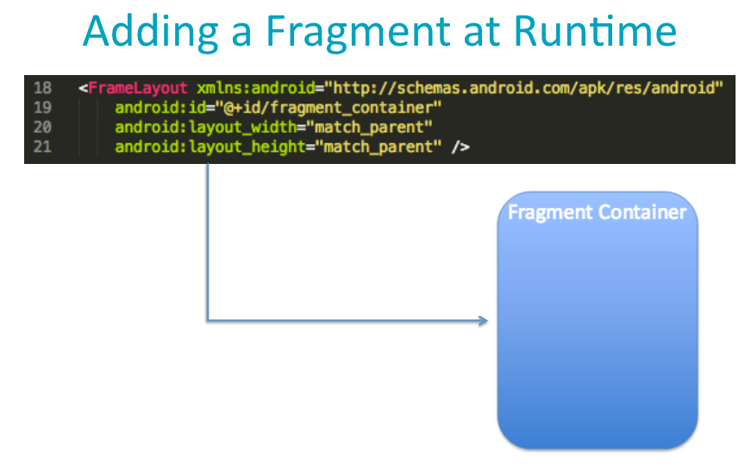
www.hndit.com

Slide 18
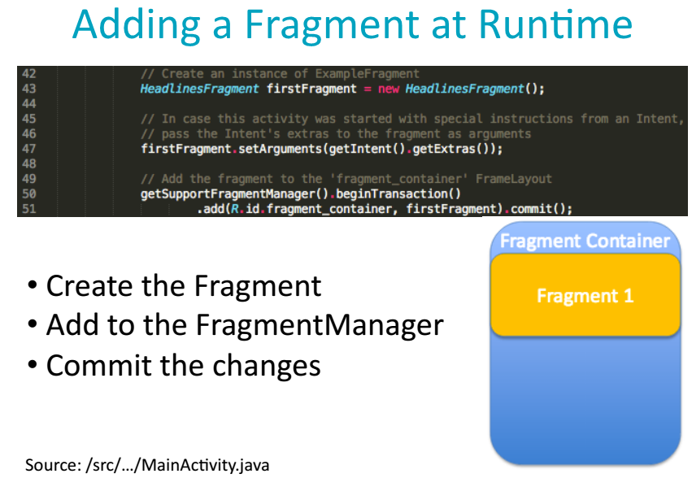
www.hndit.com

Slide 19
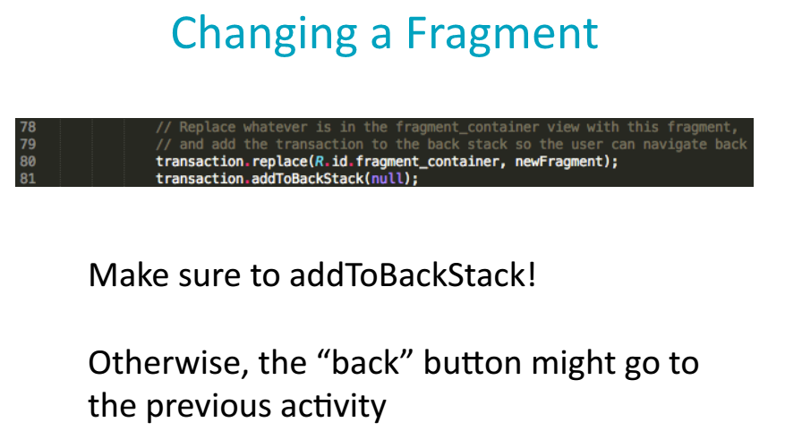
www.hndit.com

